Slide 1
Basics of Materials Requirement Planning(MRP)

Slide 2
Materials
Materials are key resource in an industrial enterprise
Production is not possible without materials
Materials cost is major constitute of the cost of the product
Proper control over material purchase, storage, issue, movement and consumption is necessary. Materials management does this for enterprise

Slide 3
Material Planning
Materials planning is important function of materials management
Materials planning is the scientific way of determining requirements of raw materials, bought out part and others and ensuring their availability in the right quantities, at right time with minimum capital locked up
Lack of materials planning causes ill-planned purchased which gives over ordering and under ordering. Over ordering results in over investment, improper use of working capital, shortage of storage facilities and deterioration of stock. Under ordering causes stock outs and partial utilization of facilities.
Lack of materials planning leads to unwanted emergency orders which are usually processed at high cost.
Improper materials planning increases work load of the purchase department, receiving stores and inspection hence increasing manpower requirement.

Slide 4
Techniques of Materials Planning
Materials Group | Technique
A. Direct Materials
a) High Value | Bill of materials/ Explosion Charts MRP Inventory Control
b) Low Value | i) Inventory Control
B. Indirect Materials | Past Consumption Analysis Moving Average method Exponential smoothing Inventory Control

Slide 5
MRP- Introduction
Materials requirement Planning (MRP) is determining the number of parts, components and materials needed to produce product
MRP provides time scheduling information specifying when each of the materials, parts and components should ordered or produced
Definition
“ MRP constitutes a set of techniques that use bill of materials, inventory data and master production schedule to calculate requirements of materials”
-APICS Dictionary

Slide 6
Materials requirement Planning(MRP)
Objectives of MRP
1) Determine requirements
MRP main objective is to determine what components are needed to meet master production schedule and based on lead time, to calculate periods when the components must available. It must determine
What to order
How much to order
When to order
When to schedule delivery
2) Keep priorities current
The demand and supply of the components changes daily. Customer enter or change orders. Component get used up, suppliers are late with deliveries, scrap occurs, machine break down. In this ever changing world MRP reorganize the priorities to keep plan current. It must be able to add, delete, expedite, delay and change orders

Slide 7
Material Requirement planning system
Based on a MPS , a material requirement planning system
Creates schedules identifying the specific parts and materials required to produce end Items
Determines exact unit number needed
Determine the dates when orders for those materials be released, based on lead time

Slide 8
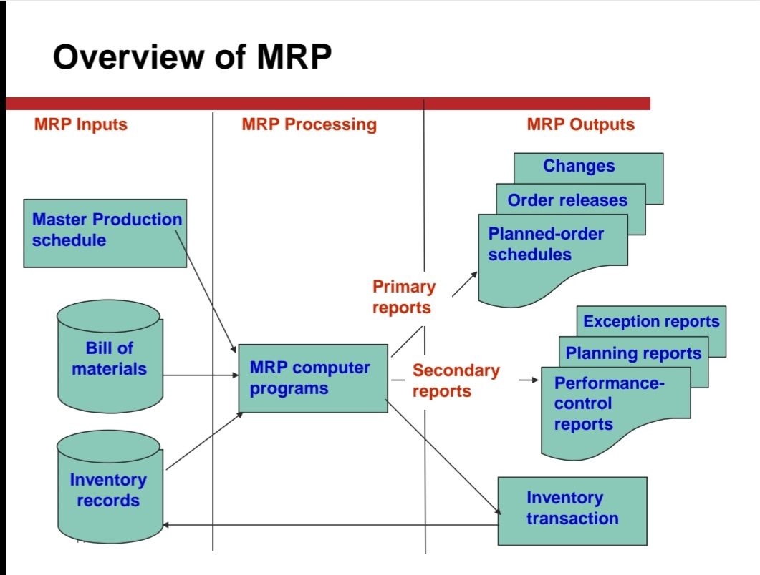

Slide 9
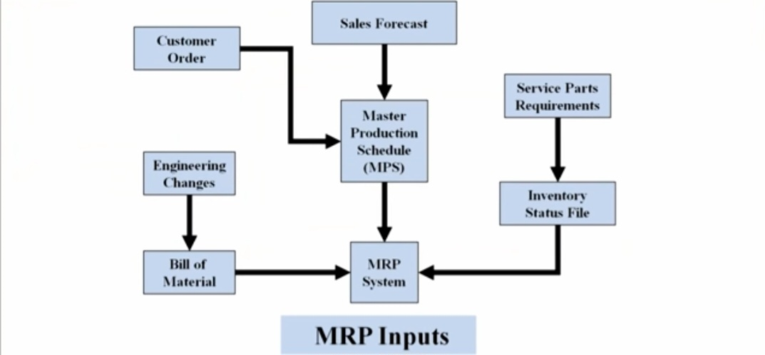
Inputs to MRP

Slide 10
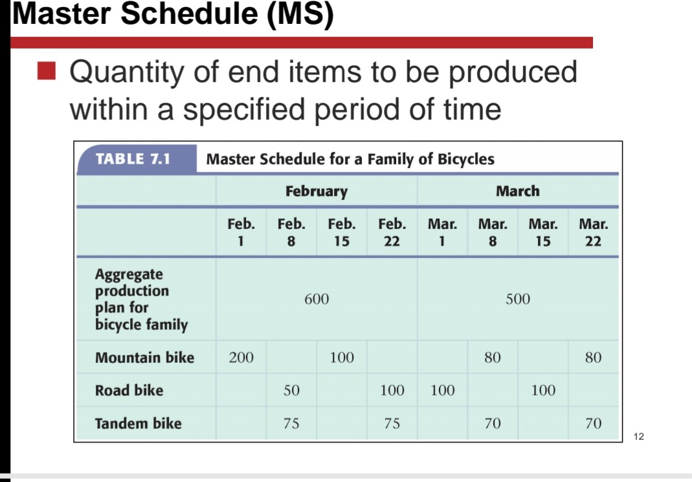
Inputs to MRP
Master production schedule-
-It is statement of which end items are to be produced, the quantity of each, and the dates they are to be completed. It provides initial input to MRP for the items needed.
It is list of items , indicating end products to be produced. This contain item name and code, quantity to be produced and the timings for completing production
This is based on estimates of product demand i. e. sales forecast

Slide 11
Bill of Materials
BOM is very important document which gives requirement of the inventory.
Bill of materials(BOM) also called part list or building list
It is document generated at the design stage
It details the structure of the product by dividing the final assembly into major assemblies, Major assemblies into sub assemblies and sub assemblies into parts.
BOM provides details such as part number, description, quantity required, material specifications etc.
For determining the materials requirement each product is split ( Product Explosion) its basic requirement( Bought out parts, work made parts and raw material for it) by using BOM
Quantity required per item multiplied by quantity of the product to be produced gives total requirement of each product.
Requirements are adjusted for rejection during manufacturing
BOM technique is suitable for engineering industry since large number of components are required for final product.
BOM file is revise every time there is change in product design or specification

Slide 12
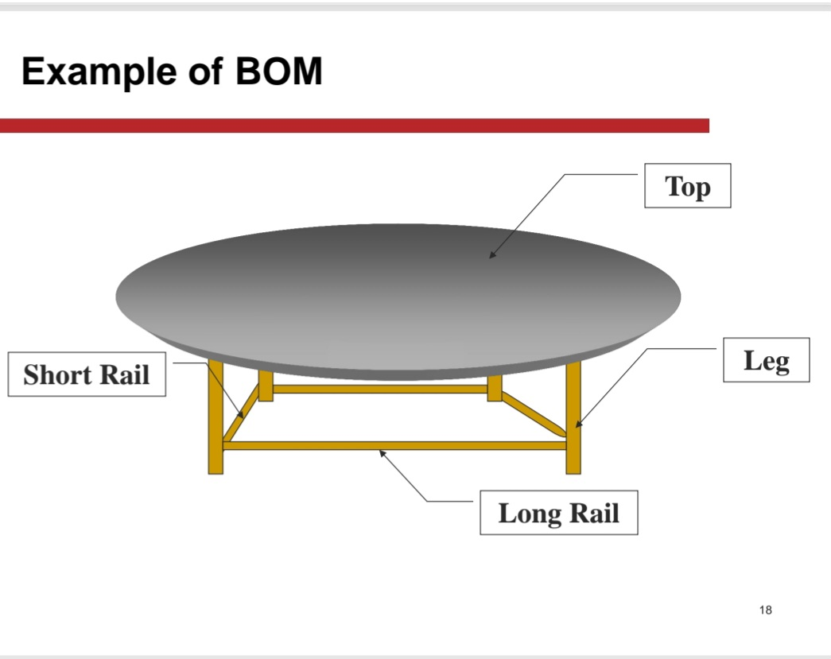

Slide 13
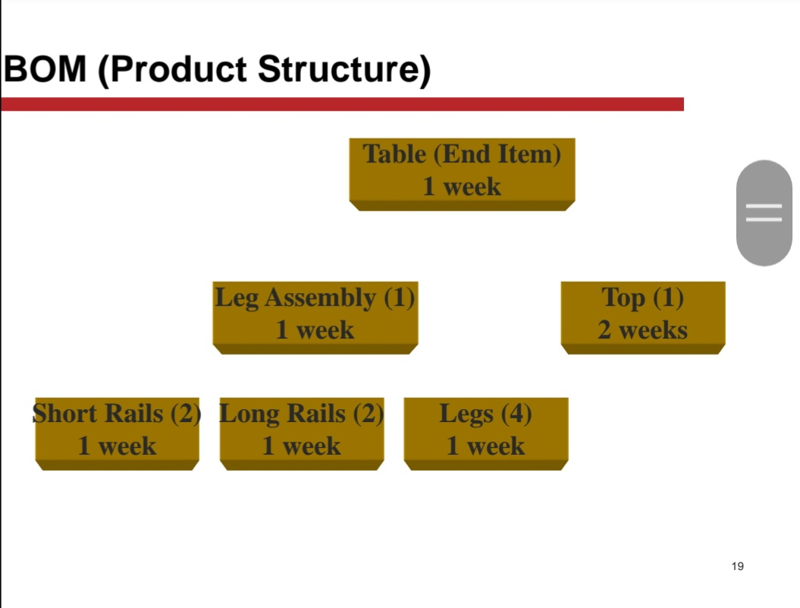

Slide 14
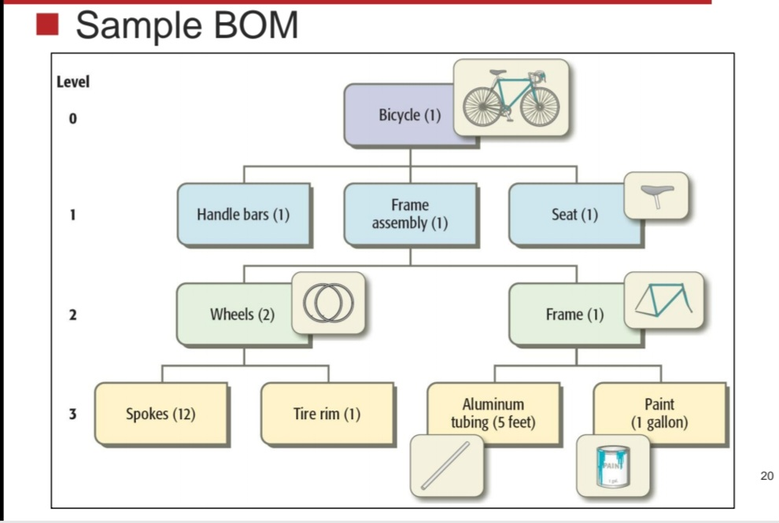

Slide 15
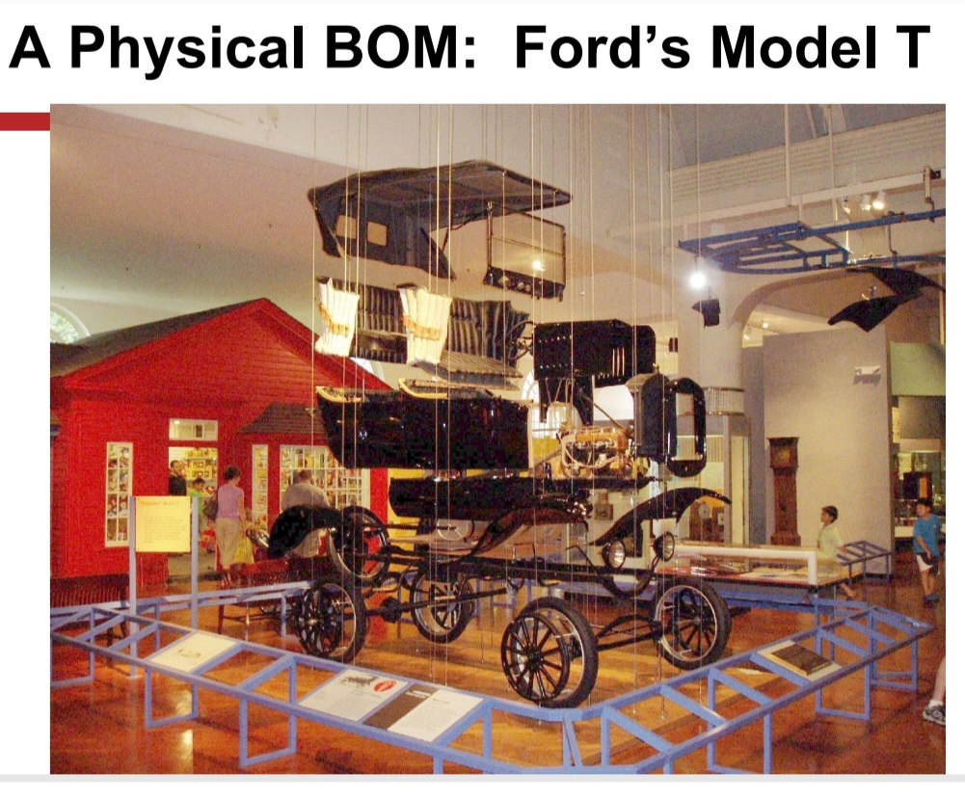
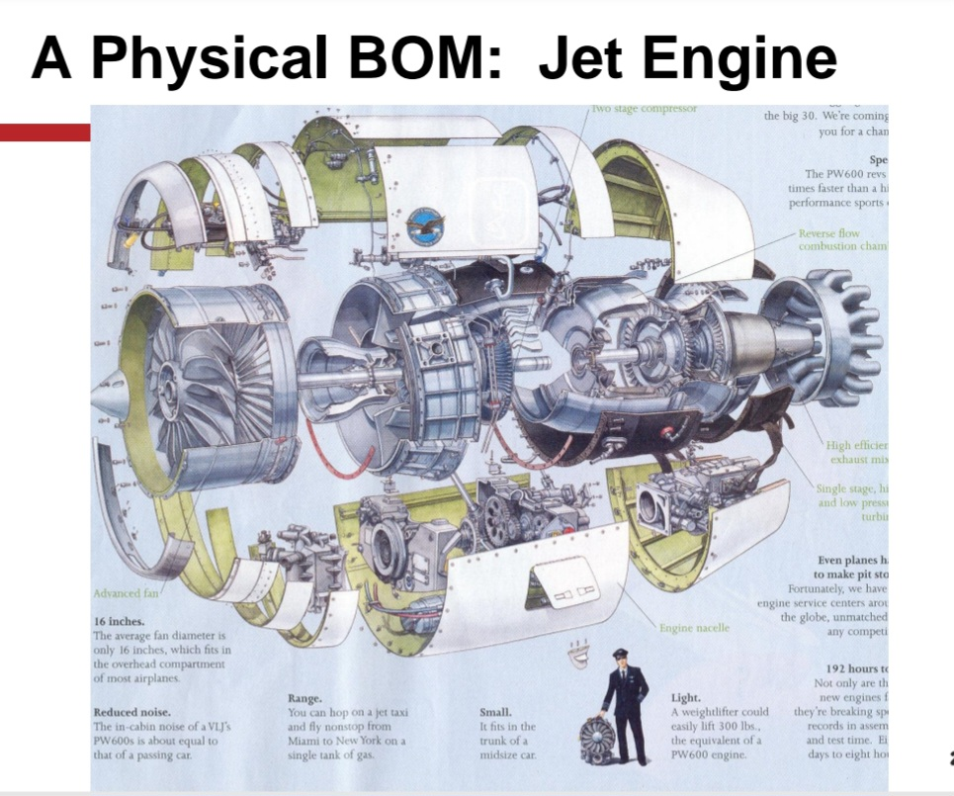

Slide 16
X
A(1)
D(1)
E(2)
C(2)
I(2)
Level 0
Level1
Level 2
B(3)
H(2)
G(1)
D(1)
J(1)
Level 3
Level 4
B(1)

Slide 17
Inventory Records-
A major input to the MRP system is inventory. When calculation is made to find out how many are needed, the quantities available must be considered.
There are two kinds of information needed. First is planning factors such as order quantities, lead times, safety stock and scrap. This information is needed to plan what quantities to order and when to order for timely delivery.
Second information needed is status of the each item. MRP requires how much is available, how much is allocated and how much is available for future demand. This information is dynamic and changes with every transaction. Such data maintained in an inventory record file
It provides computerized record of each material physically held in the system
There will be only one inventory status for individual material, even if it is used in different levels of production or different end products.
The file indicates material code, material name, inventory on- hand( physically available), inventory on order( ordered but yet to arrive), customer order for item

Slide 18
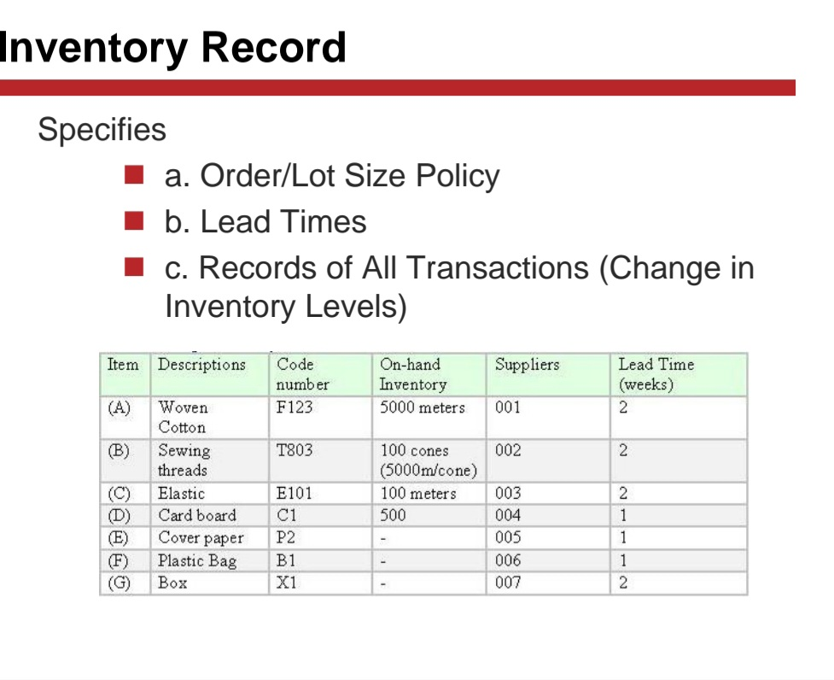

Slide 19
Steps Involved in MRP
Determine gross requirement of finished product
Sales Orders
forecast
Inventory on hand
Determine net requirement of finished product
Develop MPS
Aggregate inventory requirements
Explode BOM to determine GPR
Component parts and raw materials inventory
Determine NPR
Issue Planned orders
Scrap Allowance
Adjust requirement for scrap allowance
Compared planned and delivered
Schedule/release planned orders
NO
Have all level been exploded
Yes
Expedite(If necessary)

Slide 20
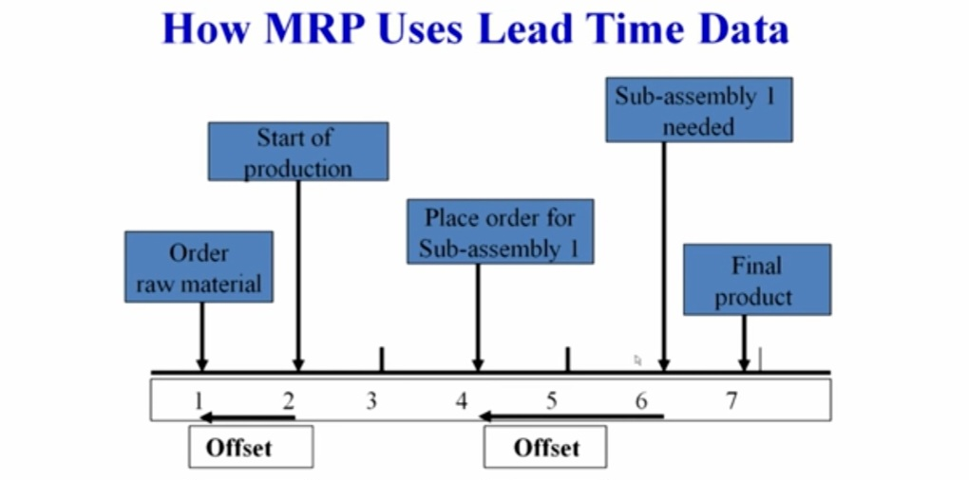
Lead Time
It is time needed for completing the job from the initial stage to the final stage
Ordering lead time- Start of purchasing process to receipt from supplier(s)
Manufacturing lead time – processing of part through the machines specified on route sheet

Slide 21
Characteristics of demand
Dependent demand
- Product demand related to other items as item is component of other product
Lumpy Demand
- Demand is sudden or in large quantity/ increased so as to make a batch of final product

Slide 22
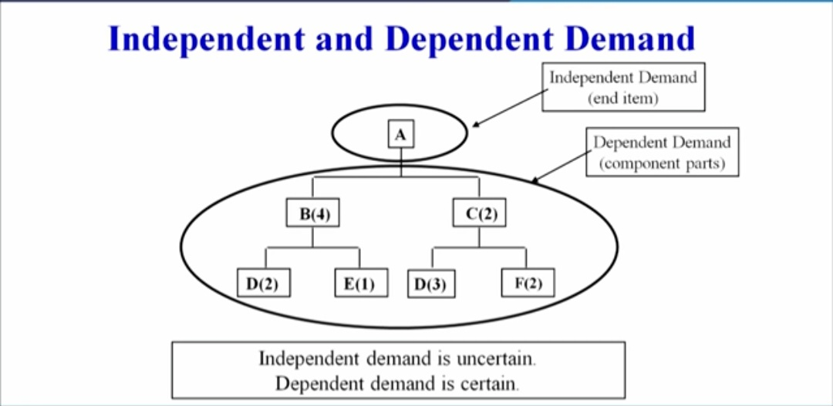

Slide 23
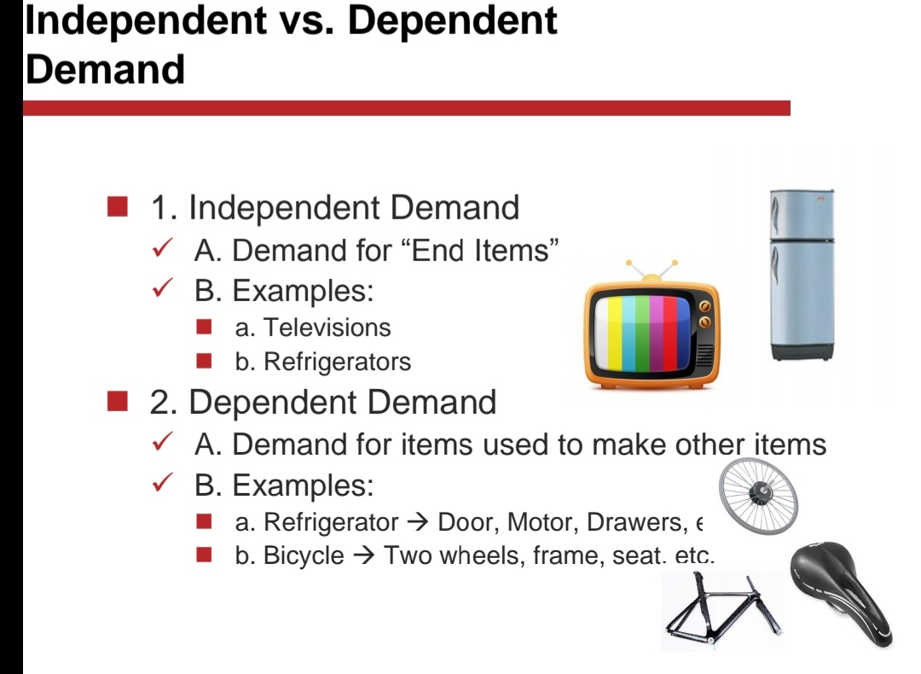

Slide 24
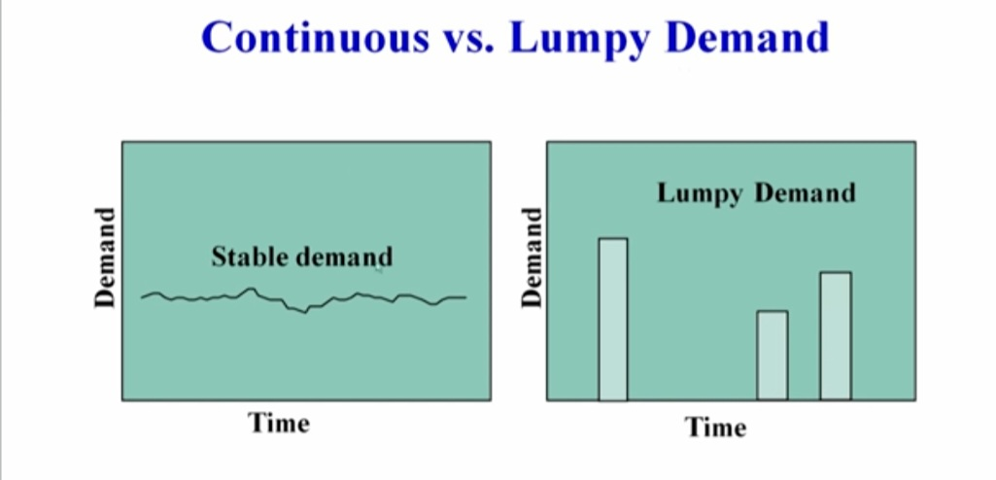

Slide 25
How MRP works
Bucketing
At what time and in what quantity a product is needed
MRP starts with consolidating period requirement for different end products
These time periods are call “ Buckets”
Add services (spare parts), which are not included in MPS
Part Explosion
-Each item exploded ( divided) into constituents materials.
Offsetting
-Displacing requirement by a period equal to the lead time of the product

Slide 26
Aggregation
-Finding gross requirement for each component
Netting
- involves modification of aggregated (or gross) requirement
Net Req. =( Gross req.) - ( inventory on hand - safety stock - inventory allocated to other users)
Procurement schedule
- The requirement is now advanced by a lead time for final assembly
Lot sizing
-This is used to consolidate the requirement in pre-specified lot , so the “ Economic order Quantity” may be ordered

Slide 27
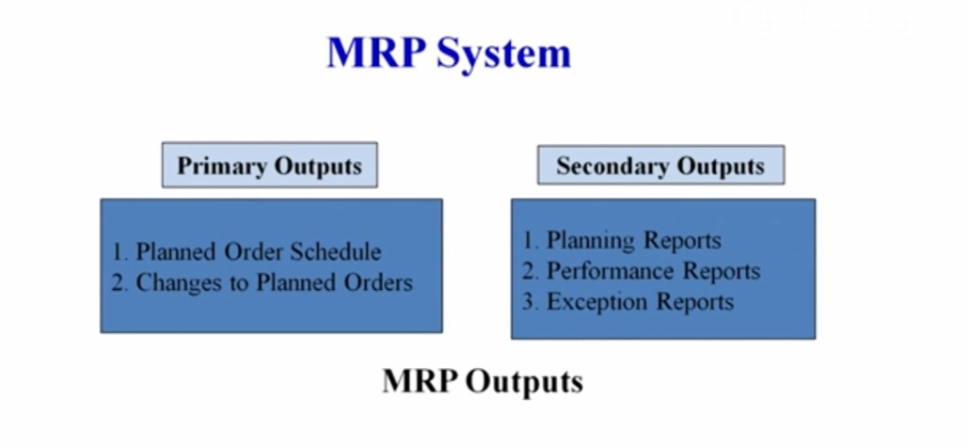
MRP Outputs

Slide 28
MRP Outputs
Primary outputs
Planned order schedule
Used to determine future production and supply at suppliers end along with guide for in-house production schedule
Changes in planned orders
Modification in previously planned orders
Secondary outputs
Planning report
Used for future planning of inventory
Performance reports
Used to determine agreement between actual and programmed usage and cost
Exception reports
Used to point out serious discrepancies such as late or overdue orders

Slide 29
Benefits of MRP
Assurance that materials and components will be available when needed
Minimized inventory levels and cost associated
Optimized inventory management
Reduced customer lead times
Increased manufacturing efficiency by using accurate production planning and scheduling
Ensure effective capacity utilization
Increased overall customer satisfaction
Reduce purchasing cost
Less scrap and rework
Reduce manufacturing cost
Increase productivity
Improve production and supply schedule

Slide 30
Disadvantages of MRP
MRP systems can often difficult and expensive to implement
Lack of flexibility
Highly dependent on accurate information about key inputs
Gives wrong estimates of materials requirement if one or two inputs are inaccurate
While MRP designed for inventory control companies are tempted to hold more inventory than is necessary.

Slide 31
Inaccuracy in supplier’s lead time – MRP heavily depends on correctness of lead time data.
Inaccuracy in inventory data- Miscounting, unaccounted scrap, items lost in transit
Inaccuracy in manufacturing lead time- Change in customers demand , changes in workload of factory
Inaccuracy in BOM structure- Changes in design, component substitution without recording

Slide 32
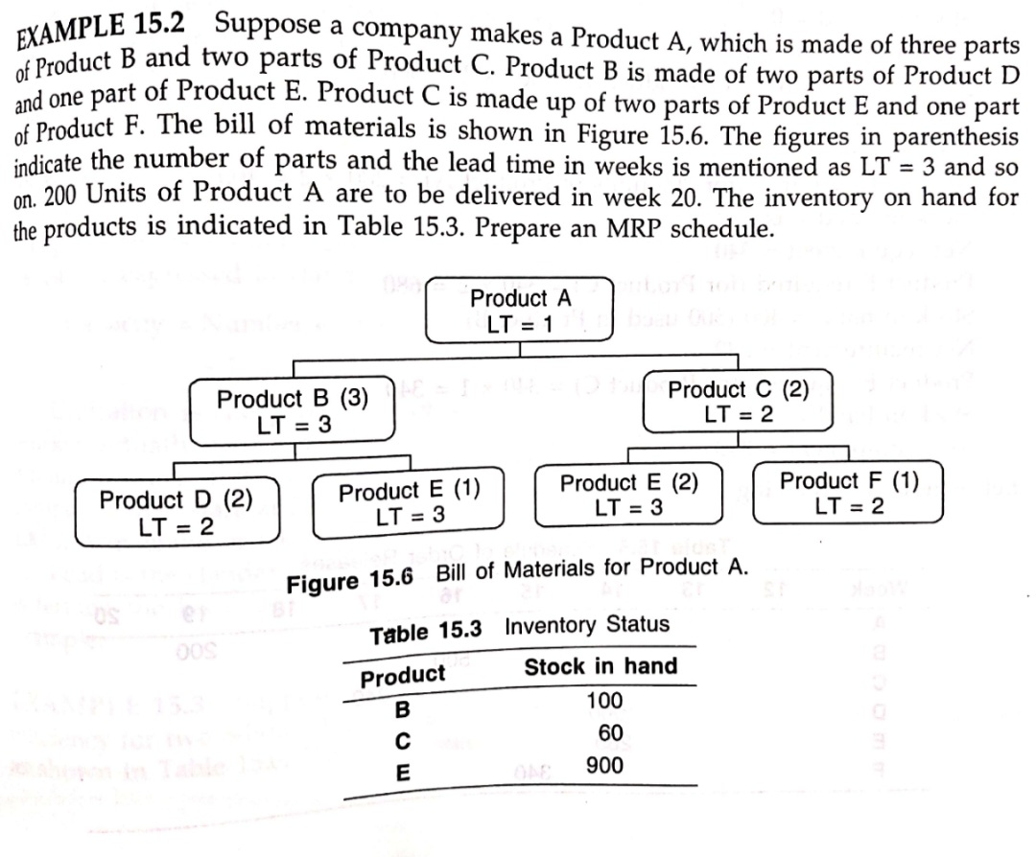
MRP Example

Slide 33
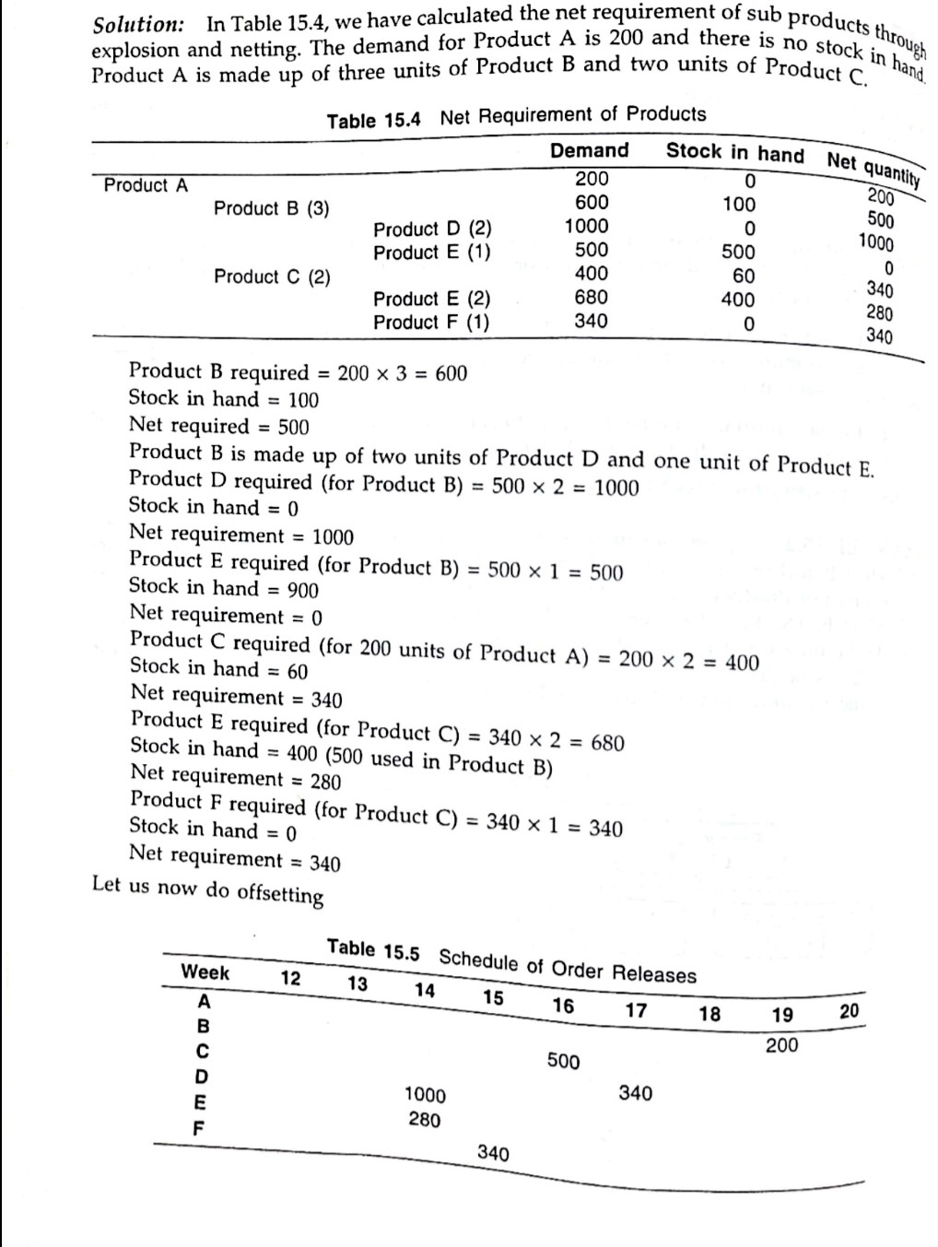

Slide 34
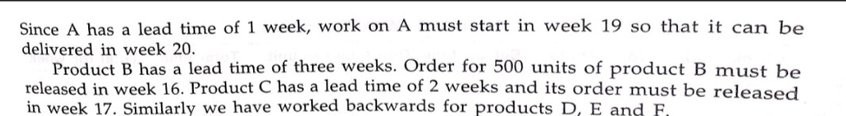

Slide 35
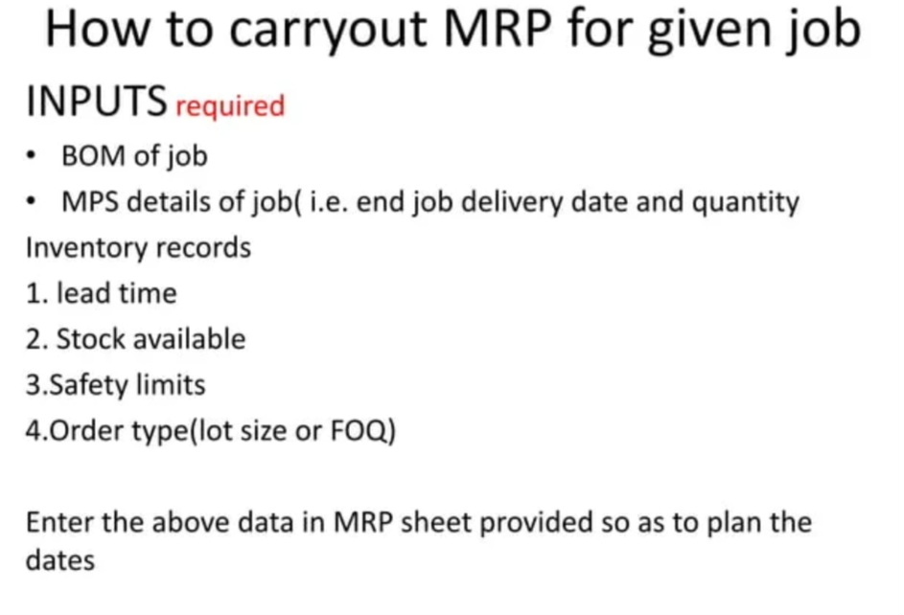

Slide 36
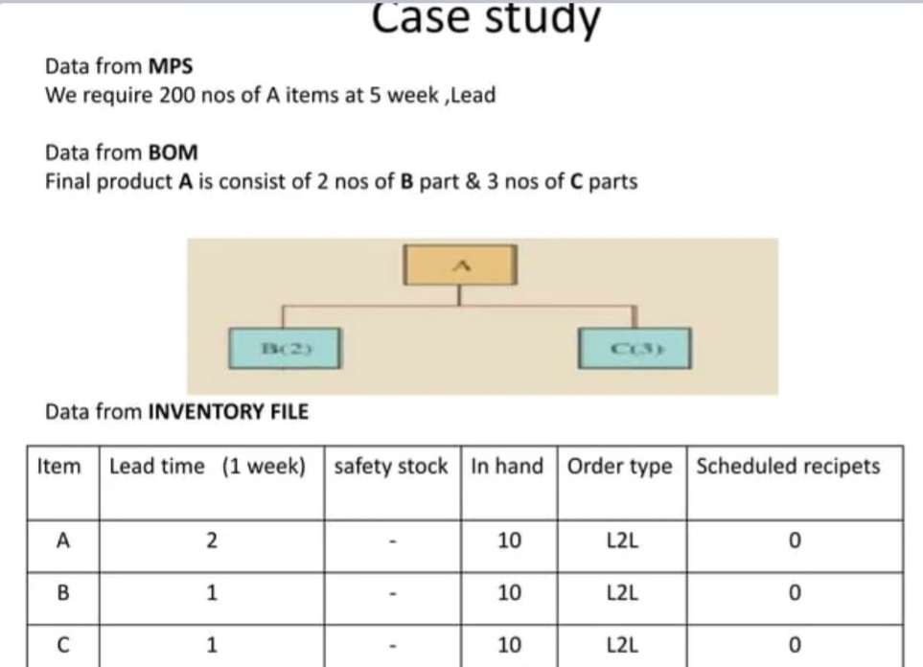

Slide 37
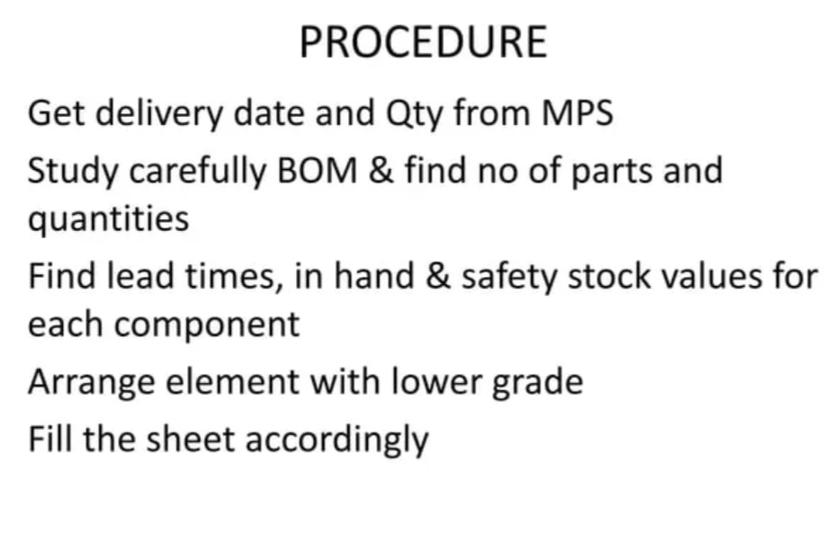

Slide 38
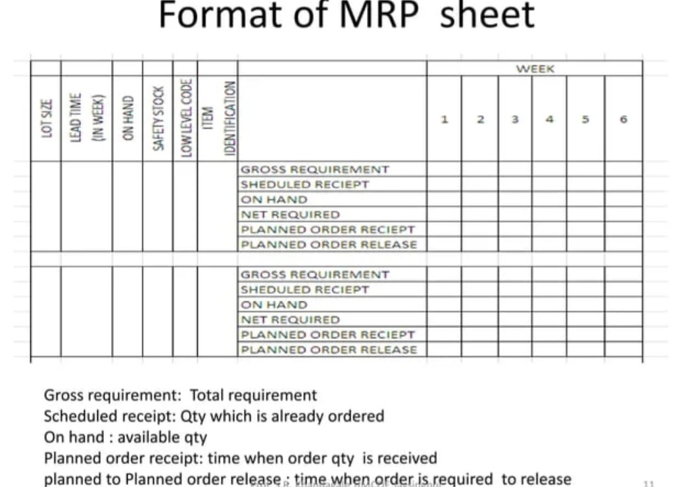

Slide 39
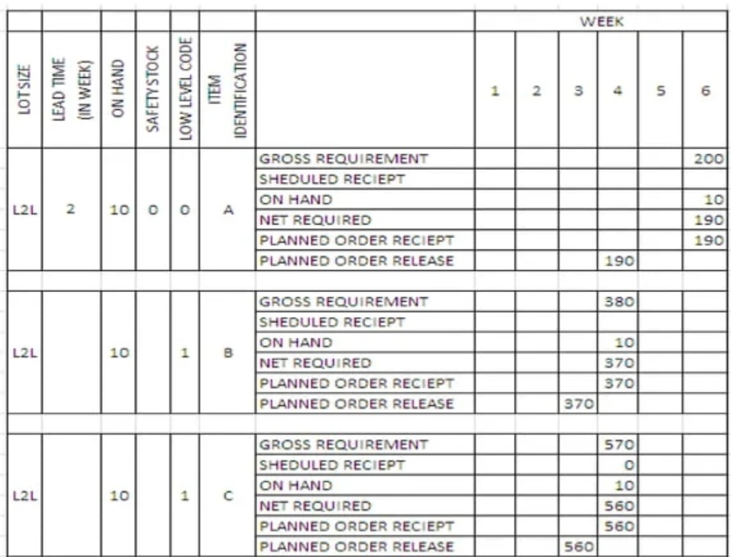

Slide 40
Who Can Use an MRP System?
Although most of us believe that MRP is a function that only applies to manufacturers, the word “manufacturer” can be broad. In MRP, a manufacturer is an organization that acquires goods or materials and transforms them to create a different product that consumers can buy. As a result, many businesses use MRP systems. This include:
Warehouses that package or assemble collections of items into “kits” or combinations for resale as a whole.
Companies that manufacture a single product in large quantities, such as cars or appliances.
Businesses that make products with long production times, such as boats or airplanes.
Custom manufacturers that make products to customer specifications.
Job shops that make products in small batches or one at a time.

Slide 41
Service providers also use MRP systems, though not as commonly as manufacturing. Service providers that may use an MRP system include:
Hospital and other medical facilities for managing inventory of medical supplies.
Law firms for tracking list of office supplies.
Printing companies for managing a list of paper and other printing supplies.
Advertising agencies for maintaining a list of media materials.

Slide 42
Conclusion
MRP is a….
Computerized inventory control
Production planning system
That….
Schedules components as needed
Which will
Track inventory and….
Help a company in many other aspects of business

Slide 43
Conclusion
Material Requirements Planning is a great tool to use in complex assembly operations or for dependent demand calculations using the Bill of Material as the foundation for how many of an item are needed for each end-time and the lead time for ordering and receiving the components.
Advancements like MRP II and ERP have been able to link manufacturing with other areas of business such as finance and marketing.

Slide 44
Questions for Continuous Internal Evaluation
Q.1) Define MRP. Give the objectives of MRP
Q. 2) what do you understand by dependent demand and independent demand?
Q.3) what is bill of material ?
Q. 4) describe the inputs and Outputs of the MRP
Q.5) Describe the steps followed to make a material requirement planning
Q. 6) What is role of MPS in MRP?
Q.7 ) what are the advantages and disadvantages of MRP ?

Slide 45
Thank You

